Slide 1
Cross Platform App Development (Movie App)
Saurabh Kumar(93038)
Rajeev Kumar(93048)
Garima Maharaj Singh(93071)
Team : 07
Batch: 2022 2Y 'B'

Slide 2
Introduction
Movie App is a cross platform mobile application that lets users discover and explore information about movies. Users can search for movies, view details.
User Can explore the cast of the movies and see the ratings of the movie.
Users can also proceed to book tickets based on their own preferences, time and date.
Tech Stack:
Frontend: React Native
Backend: Java
Database: Firebase
Authentication: Firebase
APIs: Movie database API (e.g., TMDb)

Slide 3
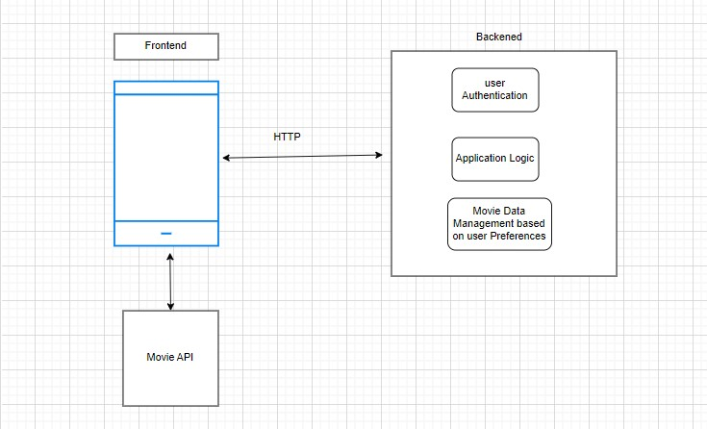
Architecture Design

Slide 4
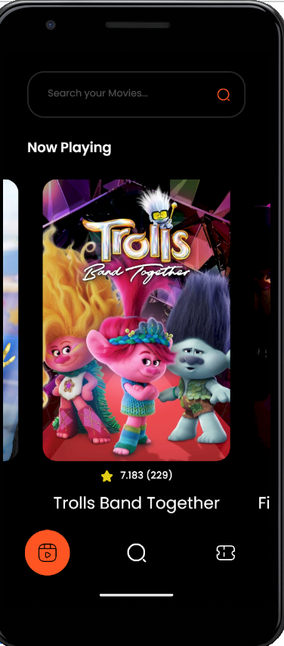
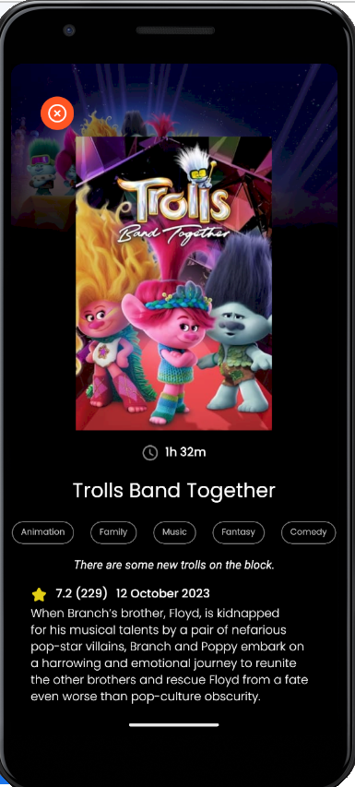
Screenshots of Project (Android)

Slide 5
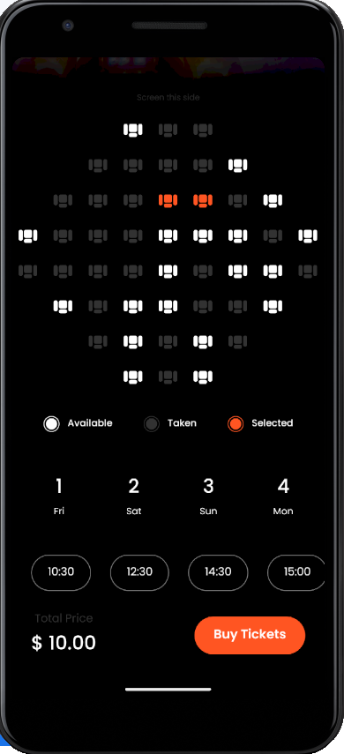
Screenshots of Project (Android)

Slide 6
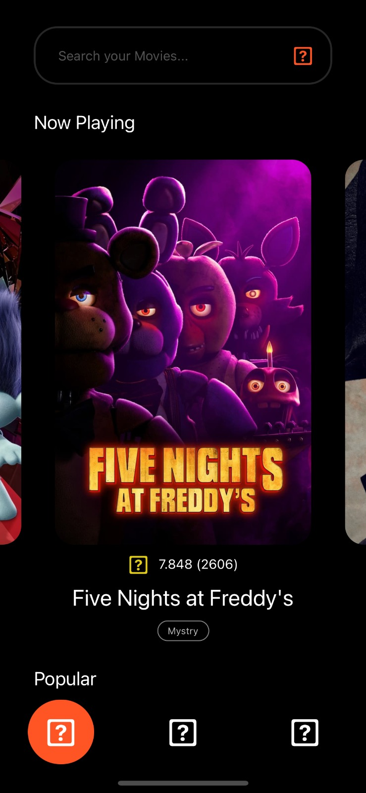
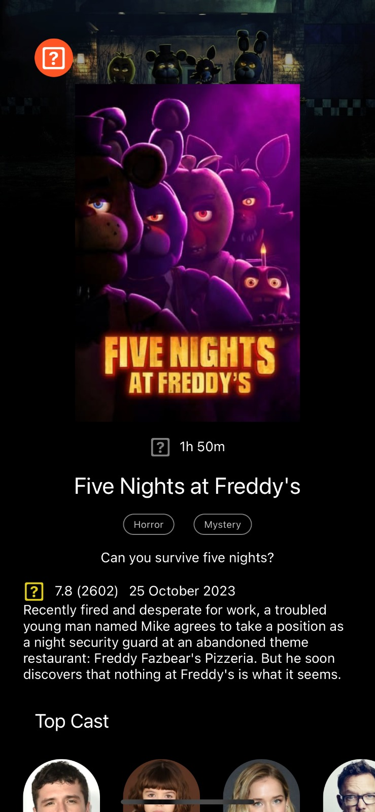
Screenshots of Project (IOS)

Slide 7
Challenges
Efficiently retrieving and managing data from the movie database API.
Designing a responsive and visually appealing interface for both mobile and tablet devices.
Maintaining Session for the logged user specific time.
While booking, the number of seats selected were not getting persisted, which was kind of technical barrier for us to solve.

